Slide 1
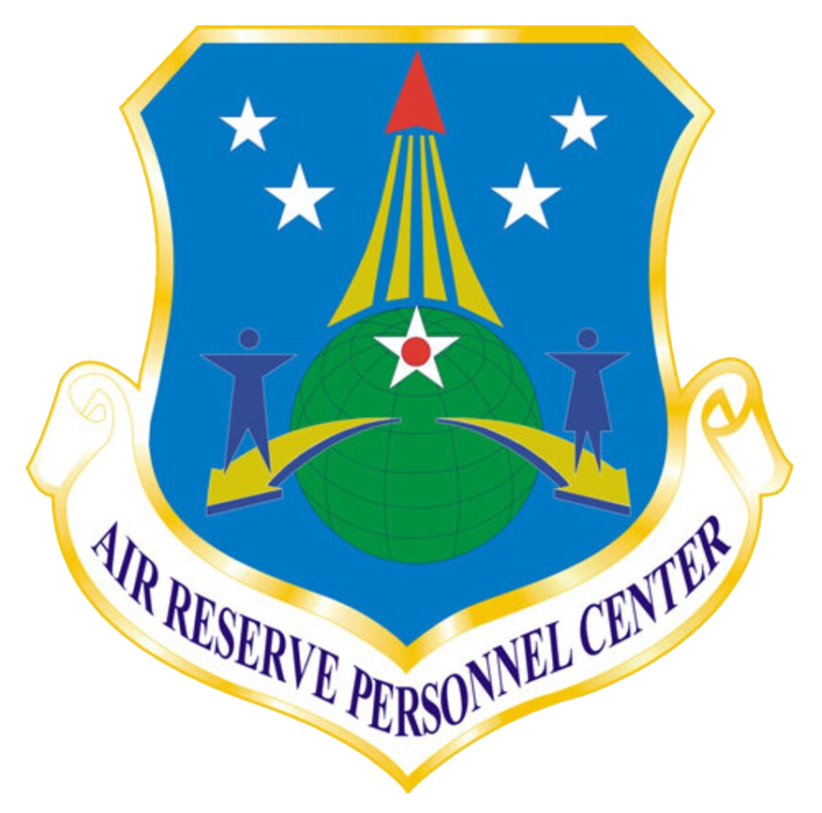
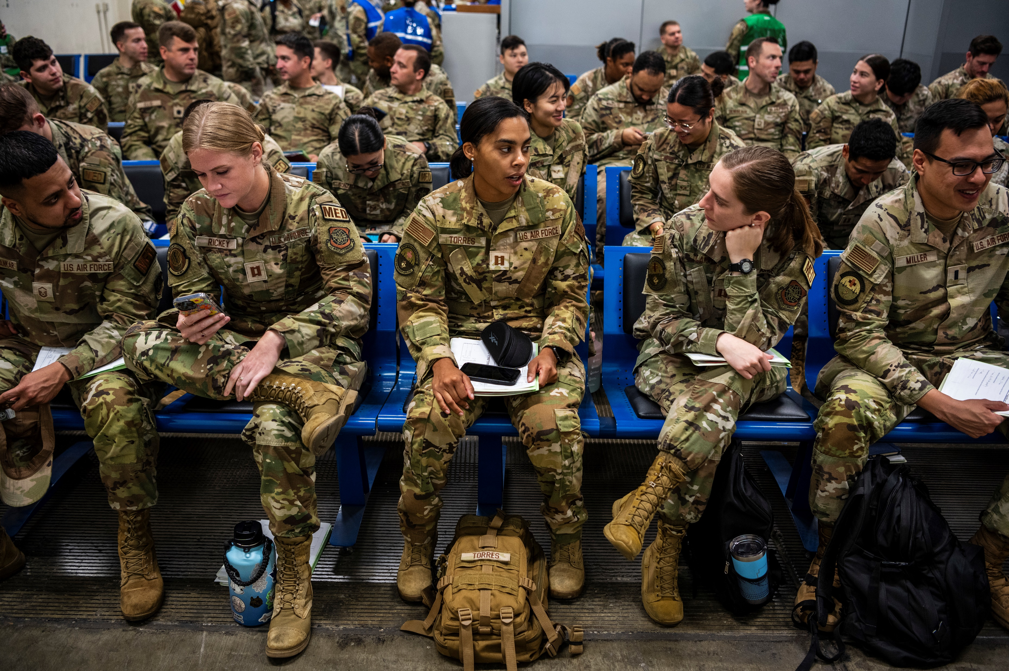
Active Guard Reserve Continuation Decision Board
WHAT YOU NEED TO KNOW
What’s Coming?
The Air Reserve Personnel Center (ARPC) is pleased to announce the upcoming release of the Jan 2024 Active Guard Reserve (AGR) Continuation Decision (ACD) Board. The ACD board has transitioned from MyPers to MyVECTOR under “My Boards”.
The ACD Program Guide can be accessed through https://www.arpc.afrc.af.mil/Services/Digital-Transformation/. The guide provides details regarding eligibility factors, key program deadlines, roles & responsibilities, and Frequently Asked Questions. Use the ACD Program Guide as a starting point to better understand the program and application process.
How Does this Benefit Me?
Members with a Date of Separation (DOS) between 1 January 2025 – 30 June 2025 and who have not been on the same AGR order longer than five years, are eligible for the Jan 2024 ACD Cycle
Allows AGR Members to extend or separate from the AGR program to enable career progression
How Can I Prepare for the Transition?
Attend at least one of two Townhall Meetings via Teams on the dates below:
  17 Jan 2024 @ 0900-1000 MT – ** Click here to join the meeting **
  24 Jan 2024 @ 0900-1000 MT – ** Click here to join the meeting **
  Access and review the AGR Continuation Decision Program Guide to learn more about the program and transition to MyVECTOR
Access the MyVECTOR platform
The MyVECTOR platform is enabled by OKTA single sign-on (CAC users only). Using Google Chrome, you can access MyVECTOR at https://myvector.us.af.mil/.

